Slide 1
Module 7 Patterns – Part 4
Harvinder S Jabbal
SSZG653 Software Architectures

Slide 2
Map-Reduce Pattern

Slide 3
Map-Reduce Pattern
Context: Businesses have a pressing need to quickly analyze enormous volumes of data they generate or access, at petabyte scale.
Problem: For many applications with ultra-large data sets, sorting the data and then analyzing the grouped data is sufficient. The problem the map-reduce pattern solves is to efficiently perform a distributed and parallel sort of a large data set and provide a simple means for the programmer to specify the analysis to be done.
Solution: The map-reduce pattern requires three parts:
A specialized infrastructure takes care of allocating software to the hardware nodes in a massively parallel computing environment and handles sorting the data as needed.
A programmer specified component called the map which filters the data to retrieve those items to be combined.
A programmer specified component called reduce which combines the results of the map

Slide 4
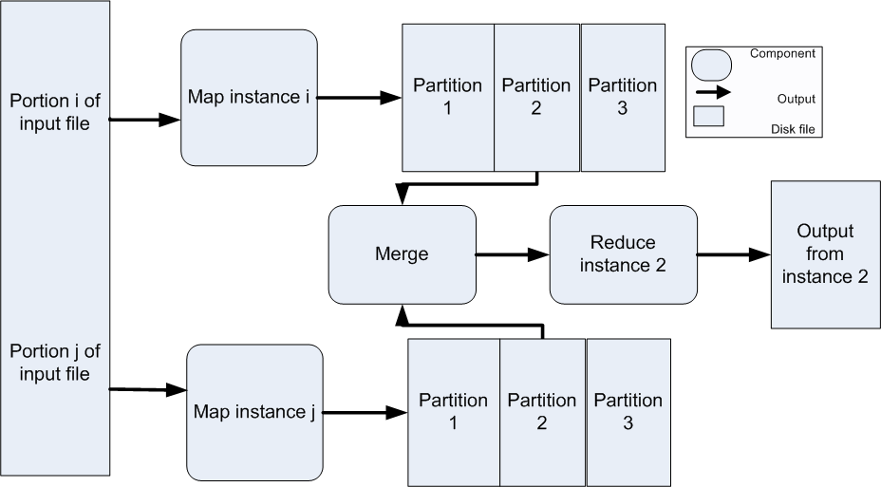
Map-Reduce Example

Slide 5
Map-Reduce Solution - 1
Overview: The map-reduce pattern provides a framework for analyzing a large distributed set of data that will execute in parallel, on a set of processors. This parallelization allows for low latency and high availability. The map performs the extract and transform portions of the analysis and the reduce performs the loading of the results.
Elements:
Map is a function with multiple instances deployed across multiple processors that performs the extract and transformation portions of the analysis.
Reduce is a function that may be deployed as a single instance or as multiple instances across processors to perform the load portion of extract-transform-load.
The infrastructure is the framework responsible for deploying map and reduce instances, shepherding the data between them, and detecting and recovering from failure.

Slide 6
Map-Reduce Solution - 2
Relations:
Deploy on is the relation between an instance of a map or reduce function and the processor onto which it is installed.
Instantiate, monitor, and control is the relation between the infrastructure and the instances of map and reduce.
Constraints:
The data to be analyzed must exist as a set of files.
Map functions are stateless and do not communicate with each other.
The only communication between map reduce instances is the data emitted from the map instances as <key, value> pairs.
Weaknesses:
If you do not have large data sets, the overhead of map-reduce is not justified.
If you cannot divide your data set into similar sized subsets, the advantages of parallelism are lost.
Operations that require multiple reduces are complex to orchestrate.

Slide 7
Multi-Tier Pattern

Slide 8
Multi-Tier Pattern
Context: In a distributed deployment, there is often a need to distribute a system’s infrastructure into distinct subsets.
Problem: How can we split the system into a number of computationally independent execution structures—groups of software and hardware—connected by some communications media?
Solution: The execution structures of many systems are organized as a set of logical groupings of components. Each grouping is termed a tier.

Slide 9
Multi-Tier Example

Slide 10
Multi-Tier Solution
Overview: The execution structures of many systems are organized as a set of logical groupings of components. Each grouping is termed a tier.
Elements:
Tier, which is a logical grouping of software components.
Relations:
Is part of, to group components into tiers.
Communicates with, to show how tiers and the components they contain interact with each other.
Allocated to, in the case that tiers map to computing platforms.
Constraints: A software component belongs to exactly one tier.
Weaknesses: Substantial up-front cost and complexity.

Slide 11
Tactics and Patterns

Slide 12
Relationships Between Tactics and Patterns
Patterns are built from tactics; if a pattern is a molecule, a tactic is an atom.
MVC, for example utilizes the tactics:
Increase semantic coherence
Encapsulation
Use an intermediary
Use run time binding

Slide 13
Tactics Augment Patterns
Patterns solve a specific problem but are neutral or have weaknesses with respect to other qualities.
Consider the broker pattern
May have performance bottlenecks
May have a single point of failure
Using tactics such as
Increase resources will help performance
Maintain multiple copies will help availability

Slide 14
Tactics and Interactions
Each tactic/pattern has pluses (its reason for being) and minuses – side effects.
Use of tactics can help alleviate the minuses.
But nothing is free…

Slide 15
Tactics and Interactions - 2
A common tactic for detecting faults is Ping/Echo.
Common side-effects of Ping/Echo are:
security: how to prevent a ping flood attack?
performance: how to ensure that the performance overhead of ping/echo is small?
modifiability: how to add ping/echo to the existing architecture?
Notes:
Tactic is fine grain adjustment of quality attributes within a pattern

Slide 16
Tactics and Interactions - 3
System
Ping/Echo
Add to
system
Ping
flood
Performance
overhead
Notes:
Tactic is fine grain adjustment of quality attributes within a pattern

Slide 17
Tactics and Interactions - 4
A tactic to address the performance side-effect is “Increase Available Resources”.
Common side effects of Increase Available Resources are:
cost: increased resources cost more
performance: how to utilize the increase resources efficiently?
Notes:
Tactic is fine grain adjustment of quality attributes within a pattern

Slide 18
Tactics and Interactions - 5
System
Ping/Echo
Add to
system
Ping
flood
Performance
overhead
Increase Available
Resources
Cost
Resource
Utilization
Notes:
Tactic is fine grain adjustment of quality attributes within a pattern

Slide 19
Tactics and Interactions - 6
A tactic to address the efficient use of resources side-effect is “Scheduling Policy”.
Common side effects of Scheduling Policy are:
modifiability: how to add the scheduling policy to the existing architecture
modifiability: how to change the scheduling policy in the future?
Notes:
Tactic is fine grain adjustment of quality attributes within a pattern

Slide 20
Tactics and Interactions - 7
System
Ping/Echo
Add to
system
Ping
flood
Performance
overhead
Increase Available
Resources
Cost
Resource
Utilization
Scheduling
Policy
Add to
system
Modify
policy
Notes:
Tactic is fine grain adjustment of quality attributes within a pattern

Slide 21
Tactics and Interactions - 8
A tactic to address the addition of the scheduler to the system is “Use an Intermediary”.
Common side effects of Use an Intermediary are:
modifiability: how to ensure that all communication passes through the intermediary?
Notes:
Tactic is fine grain adjustment of quality attributes within a pattern

Slide 22
Tactics and Interactions - 9
System
Ping/Echo
Add to
system
Ping
flood
Performance
overhead
Increase Available
Resources
Cost
Resource
Utilization
Scheduling
Policy
Add to
system
Modify
policy
Use an
Intermediary
Ensure
usage
Notes:
Tactic is fine grain adjustment of quality attributes within a pattern

Slide 23
Tactics and Interactions – 10.
A tactic to address the concern that all communication passes through the intermediary is “Restrict Communication Paths”.
Common side effects of Restrict Communication Paths are:
performance: how to ensure that the performance overhead of the intermediary are not excessive?
Note: this design problem has now become recursive!
Notes:
Tactic is fine grain adjustment of quality attributes within a pattern

Slide 24
How Does This Process End?
Each use of tactic introduces new concerns.
Each new concern causes new tactics to be added.
Are we in an infinite progression?
No. Eventually the side-effects of each tactic become small enough to ignore.

Slide 25
Summary
An architectural pattern
is a package of design decisions that is found repeatedly in practice,
has known properties that permit reuse, and
describes a class of architectures.
Tactics are simpler than patterns
Patterns are underspecified with respect to real systems so they have to be augmented with tactics.
Augmentation ends when requirements for a specific system are satisfied.

